Slide 1
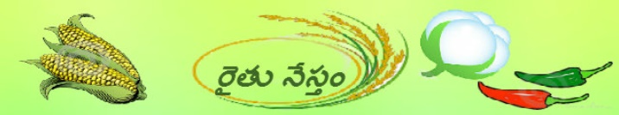
Raithu Nestham(Telugu)
A Farmer Friend
Presented By:
Anand Kuamr Potu,
VRSEC, Kanuru.

Slide 2
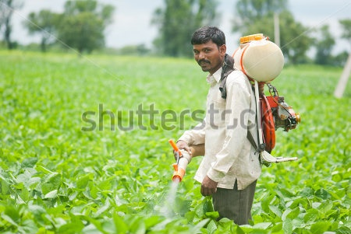
AP Farmer
Farmers are the backbone of our country.
Farmers in AP are praised as “Anna Dhata”.
Very few farmers can understand English.

Slide 3
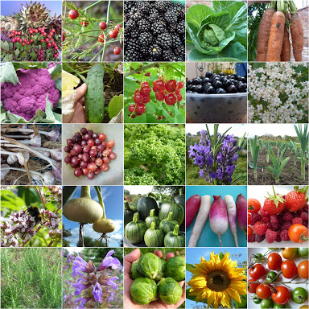
Farming
Agriculture technology is growing day by day.
If farmers are exposed to technology, farming can be very easy and productive.
Farmers have less sources to know the type of crop disease and proper pesticides have to be used.

Slide 4
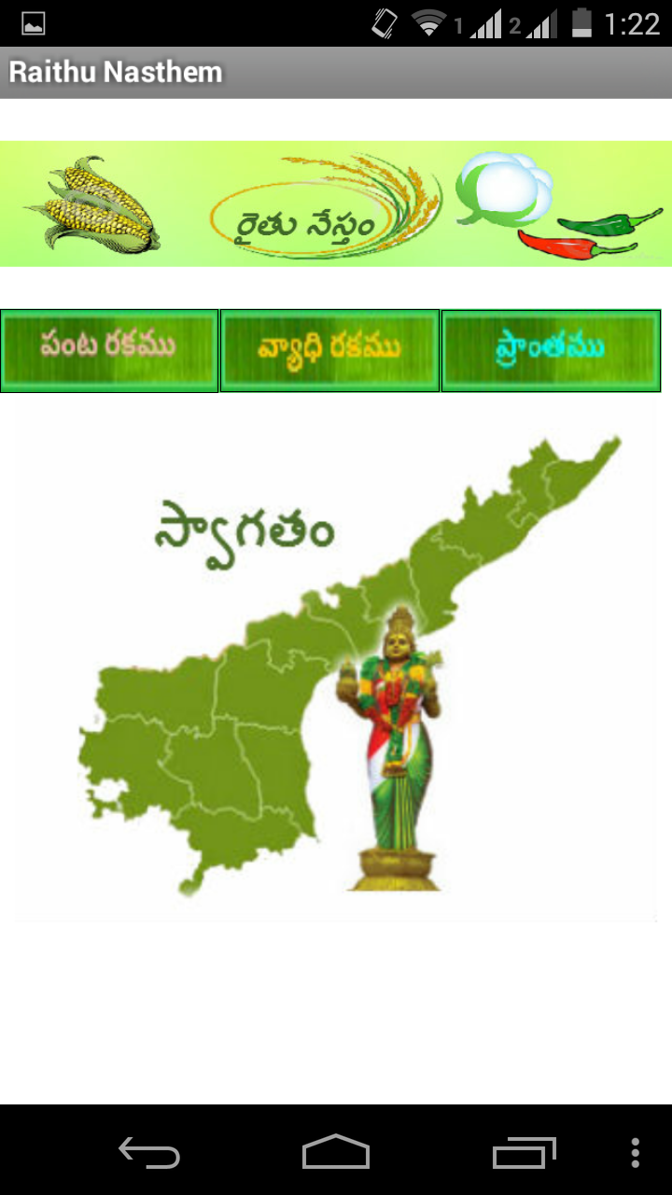
APP Details
Raithu Nasthem App is designed in Telugu.
Farmers can search details using Type of Plant (Panta Rakamu) or Type of Diseases (Vyadhi Rakamu).
Farmer can also know the details of regional crops, machinery dealers etc., using Region(Pranthamu) option.

Slide 5
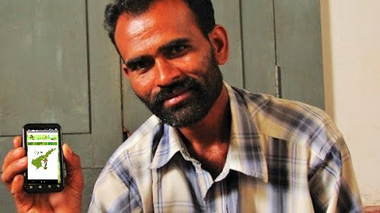
Thank You

